Slide 1

Introduction to scripting languages
PaS | Patrik Čigáš | 09/2022

Slide 2
Topics
01 | Scripting possibilities in Operating Systems GUI vs CLI Available languages
02 | Introduction to UNIX shells and Powershell Shell vs Program Script advantages
03 | Basic Syntax in Shell and Python
04 | Procedural vs Object-Oriented aproach

Slide 3
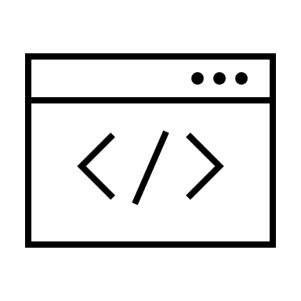
Scripting in OS

Slide 4

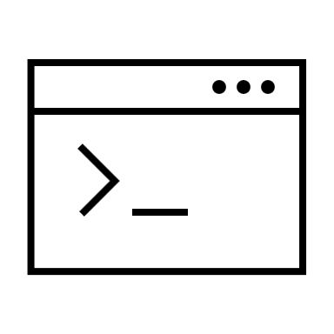
GUI vs CLI
Graphical User Interface
GUI permits users to use the graphics to interact with an operating system
Intuitive and user friendly
Requires more system memory → Slower
Usually very customizable
Command Line Interface
CLI allows to run commands to interact with Operating Systems and applications
Requires knowledge of commands
Doesn’t require additional memory → Fast
Look not as customizable as GUI

Slide 5



Unix vs Linux
UNIX is a family of multitasking, multiuser computer operating systems
Commercial OS founded in 1969 by Nokia Bell Labs
Many modern-day Operating Systems are relying on its standards. (POSIX)
Open-Source OS
Founded by Linus Torvalds
Based on Unix
Has many different distributions/variants (Ubuntu, Debian, Arch Linux, …)
Better support for filesystems than Unix
Used by every major space program, including NASA and ESA
95% of Linux is written in C language
Linux
Notes:
Penguin name – Tux
Unix is a commercial operating system built by Bell Labs in 1969. Many modern day OSes and parts of OSes are based on concepts and standards that came from Unix.
Linux is an operating system (technically a kernel, but that’s for a more technical discussion) that is similar to Unix in its design. It is compliant with many of the same standards as Unix. Unlike Unix, it is free and open-source.
Source → https://www.quora.com/What-is-the-difference-between-Shell-scriptings-and-programming

Slide 6

What is Shell?
Why is Shell?

Slide 7
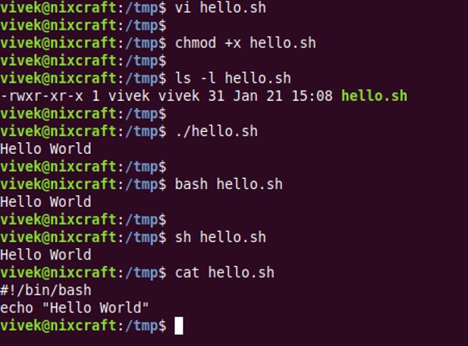
Unix Shells
Interactive Command-Line Interface, allowing users to send various instructions (commands) to operating system
Examples of UNIX shells:
Bourne Shell (sh)
Bourne-Again Shell (bash)
KornShell (ksh)
Z Shell (zsh)
Notes:
Bash and zsh are shells. A shell is a command-line interface (CLI). Before computers had graphical user interfaces (GUI), you had to communicate with them by entering words on a keyboard. For example, to make a new directory/folder, one might enter "mkdir foldername" and hit enter. The reason there are different shells, like bash and zsh, is that the original Unix shell 'sh' was very limited. People created new shells that met their needs better. Multiple shells exist today because some meet specific needs better than others.

Slide 8
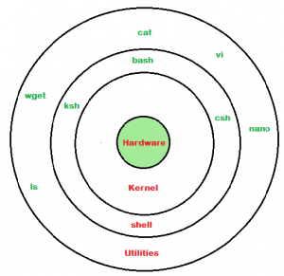
Unix Shells

Slide 9
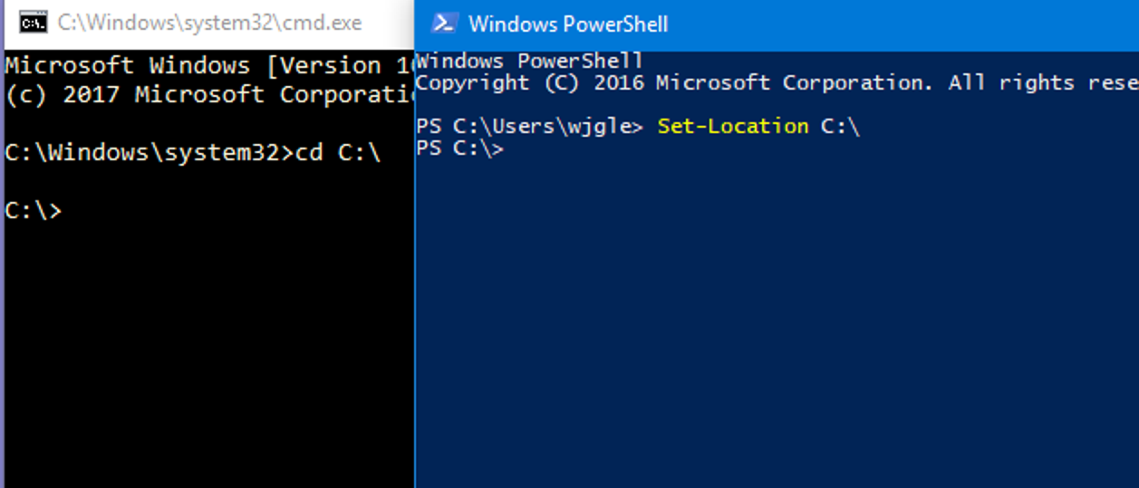
Windows Shells
CMD
Command line tool for Microsoft Windows OS
The generated output is in the form of characters.
PowerShell
Designed for System Admins
based on .Net Framework.
Advanced version of CMD
Treats input and output as objects → Object Oriented

Slide 10
What is Shell Scripting?
Shell scripting is simply taking all the commands you would type in to do something and putting them in a text file, so you don't have to type them in every time.

Slide 11


Shell vs Python

Slide 12
General comparison
Category
Bash → script.sh
Python → script.py
What is it?
Command
line interpreter
High
level programming language
Based on
object oriented
programming
Basis
Replacement for the
sh
Unix shell
languages
Purpose
Interpret user commands and automate tasks
Application and web development,
automation
Best suited for
Smaller and simple
scripts on
Linux systems
In depth programs with many lines of code,
multiple
systems
Simply runs the same commands as you would enter in
Can use objects and libraries to create
Simplicity
terminal
complicated code
Availability
Installed by default on Linux, nothing to download
May or may not be installed, some programs
rely on third party extensions

Slide 13
Shebang #!
First line in shell scripts, specifying path to the interpreter
Defines in which language the script should run
Examples:
#!/bin/sh – Execute the file using the Bourne shell, or a compatible shell, assumed to be in the /bin directory
#!/bin/bash – Execute the file using the Bash shell
#!/usr/bin/pwsh – Execute the file using PowerShell
#!/usr/bin/env python3 – Execute with a Python interpreter, using the env program search path to find it
#!/bin/false – Do nothing, but return a non-zero exit status, indicating failure. Used to prevent stand-alone execution of a script file intended for execution in a specific context, such as by the . command from sh/bash, source from csh/tcsh, or as a .profile, .cshrc, or .login file.

Slide 14
“Hello World” in each language
Bash
#!/usr/bin/env bash
name="Patrik"
echo "Hi, my name is $name"
Powershell
#!/usr/bin/pwsh
$name="Patrik"
echo "Hi, my name is $name“
Python
#!/usr/bin/env python3
name = "Patrik"
print(f"Hi, my name is {name}")

Slide 15

Exercise 1
Write a bash script to print current date and time.

Slide 16

Object-Oriented Programming (OOP)
Programming paradigm that relies on the concept of classes and objects
Class
abstract blueprint used to create more specific concrete objects.
They represent broad categories, like Car or Dog that share attributes
define, what attributes an instance of this type will have, like color, but not the value for specific object
Object
Class templates are used as a blueprint to create individual objects
Object represent specific examples of the abstract class, like myCar or goldenRetriever
Each object can have unique values to the properties defined in the class.

Slide 17
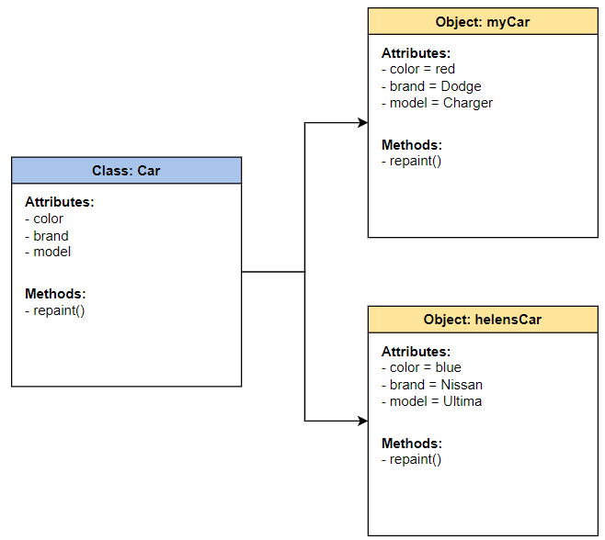
Object-Oriented Programming (OOP)

Slide 18
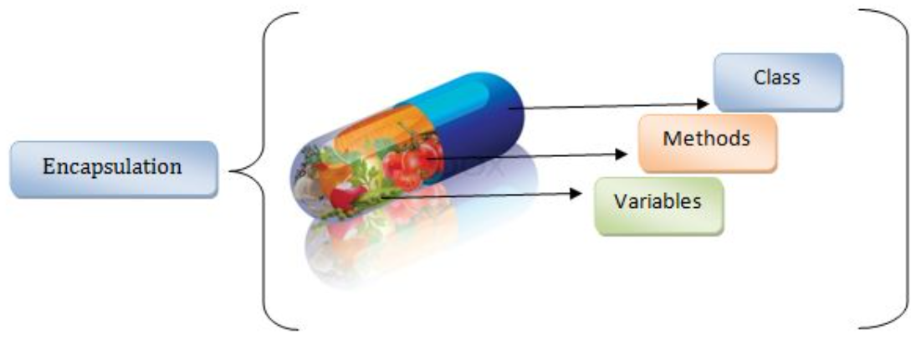
Encapsulation
Notes:
The word “encapsulate” means to enclose something. Just like a pill "encapsulates" or contains the medication inside its coating, encapsulation works in a similar way in OOP: by forming a protective barrier around the information contained within a class from the rest of the code.
In OOP, we encapsulate by binding the data and functions that operate on that data into a single unit known as the class. This hides private details of a class from the outside world and only exposes functionality important for interfacing with it. When a class does not allow calling code access to its private data directly, we say that it is well encapsulated.
Example
Imagine having a class representing person. Person can have attributes, like age, height, gender, or we even might have private data in the class, such as "socialSecurityNumber," that should not be exposed to other objects in the program. By encapsulating this data member as a private variable in the class, outside code would not have direct access and it would remain safe within that person’s object.
If a method is written in the person class to perform, say, a bank transaction called "bankTransaction()," that function could then access the "socialSecurityNumber" variable as necessary. The person’s private data would be well encapsulated in such a class.

Slide 19
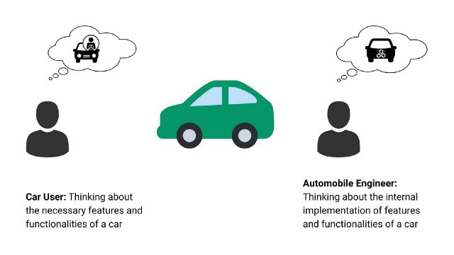
Abstraction
Notes:
Often, it’s easier to reason and design a program when you can separate the interface of a class from its implementation, and focus on the interface. This is akin to treating a system as a “black box,” where it’s not important to understand the gory inner workings in order to reap the benefits of using it.
Example
Think of a stereo system as an object with a complex logic board on the inside. It has buttons on the outside to allow for interaction with the object. When you press a button, you're not thinking about what happens on the inside because you can't see it. Even though you can't see the logic board completing these functions as a result of pressing a button, it's still performing them.
This is the concept of abstraction, which is incredibly useful in all areas of engineering and also applied to great effect in object-oriented programming.
Example 2
In OOP, we might have a class defined to represent the human body. One might define some functions as part of its publicly facing interface such as “walk()” or “eatFood().” Calling code could call these functions and remain completely oblivious to the complex inner workings of the human body and its necessary functions to perform the act of walking or eating. These details are completely hidden in the implementation of the walk() and eatFood() body functions and are abstracted away from the end-user. In these cases, it’s not important for calling code to understand how the brain coordinates walking or how the stomach manages digesting the food but rather simply that a human walked or ate.

Slide 20
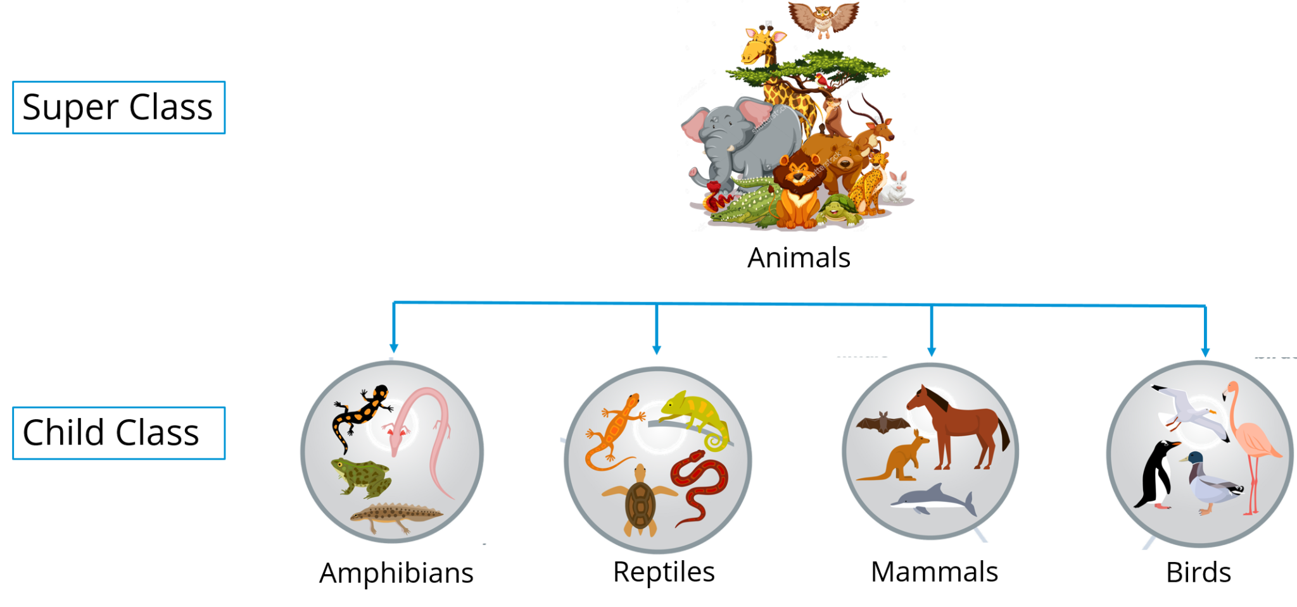
Inheritance
Notes:
Inheritance allows programmers to create classes that are built upon existing classes, to specify a new implementation while maintaining the same behaviors (realizing an interface), to reuse code and to independently extend original software via public classes and interfaces.

Slide 21
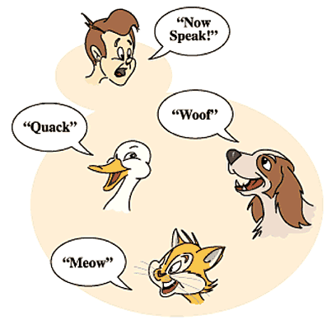
Polymorphism
Notes:
Polymorphism refers to one of the OOPs concepts in Java which is the ability of a variable, object or function to take on multiple forms. For example, in English, the verb run has a different meaning if you use it with a laptop, a foot race, and business. Here, we understand the meaning of run based on the other words used along with it. The same also applied to Polymorphism.
Example
Suppose we have a class called, “Animal” and two child classes, “Cat,” and “Dog.” If the Animal class has a method to make a noise, called, “makeNoise,” then, we can override the "makeNoise" function that is inherited by the sub-classes, "Cat" and "Dog," to be “meow” and “bark,” respectively. Another function can, then, be written that accepts any Animal object as a parameter and invokes its "makeNoise" member function. The noise will be different: either a “meow” or a “bark” depending on the type of animal object that was actually passed to the function.

Slide 22
Procedural and Object-Oriented programming

Slide 23
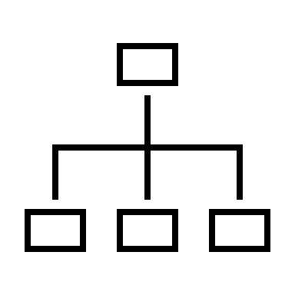



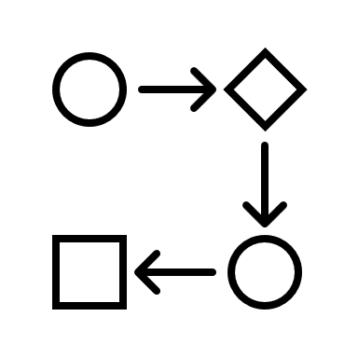
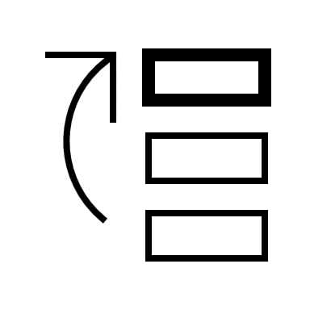

What’s the difference?
Topic
Procedural
Object
-
Oriented
Orientation
Structure/procedure
-
oriented
Object
-
oriented
Approach
Top
-
down
Bottom
-
up (more detailed)
Security
Less secure than OOP
Data hiding is possible
Access modifiers
✕
Private/Public/Protected
Inheritance
✕
✓
Importance
Functions > Data
Data > Functions
Complex problems
✕
✓
Notes:
Top-Down:
- In this approach We focus on breaking up the problem into smaller parts.
- used by structured programming languages
- Each part is programmed separately therefore contain redundancy.
- It is used in debugging, module documentation, etc.
In the top-down approach, a complex algorithm is broken down into smaller fragments, better known as ‘modules.’ These modules are then further broken down into smaller fragments until they can no longer be fragmented. This process is called ‘modularization.’ However, during the modularization process, you must always maintain the integrity and originality of the algorithm. Moreover, a top-down approach is more suitable when the software needs to be designed from scratch and very specific details are unknown.
Bottom-up:
- In bottom up approach, we solve smaller problems and integrate it as whole and complete the solution.
- Mainly used by object oriented programming language such as C++, C#, Python.
- Redundancy is minimized by using data encapsulation and data hiding.
- It is basically used in testing.
Contrary to the top-down approach, bottom-up programming focuses on designing an algorithm by beginning at the very basic level and building up as it goes. In this approach, the modules are designed individually and are then integrated together to form a complete algorithmic design. Moreover, the bottom-up approach is more suitable when a system needs to be created from some existing components.
Data Hiding → https://www.javatpoint.com/what-is-data-hiding

Slide 24
“Any fool can write code that a computer can understand. Good programmers write code that humans can understand.”
Martin Fowler
Notes:
Write short comments describing your code. It helps you understand what you did there 1 year ago.
First, solve the problem. Then, write the code.
It’s not about what you know, it’s about what you can figure out.

